Slide 1
The Multi-armed Bandit Problem:
Ants and Humans, Groups and Individuals
Stephen and Andrew

Slide 2


Slide 7
?
?
?

Slide 8
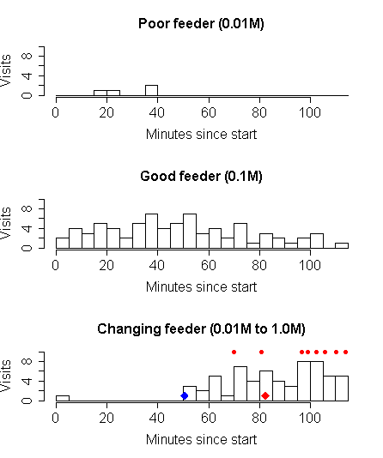
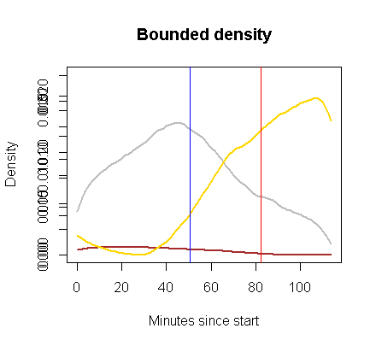

Slide 9
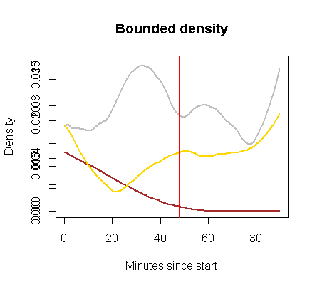
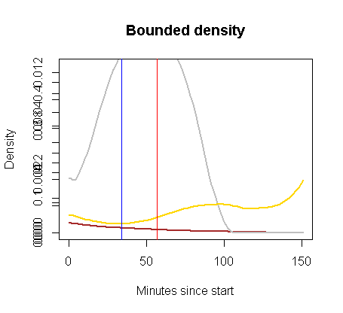
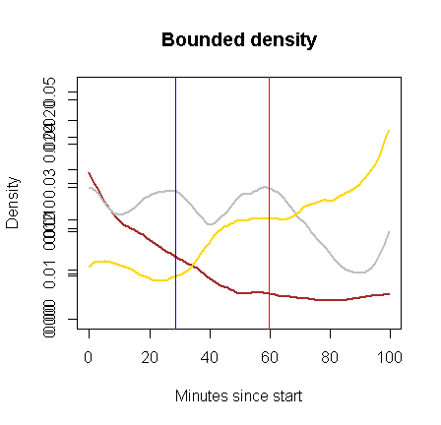

Slide 11
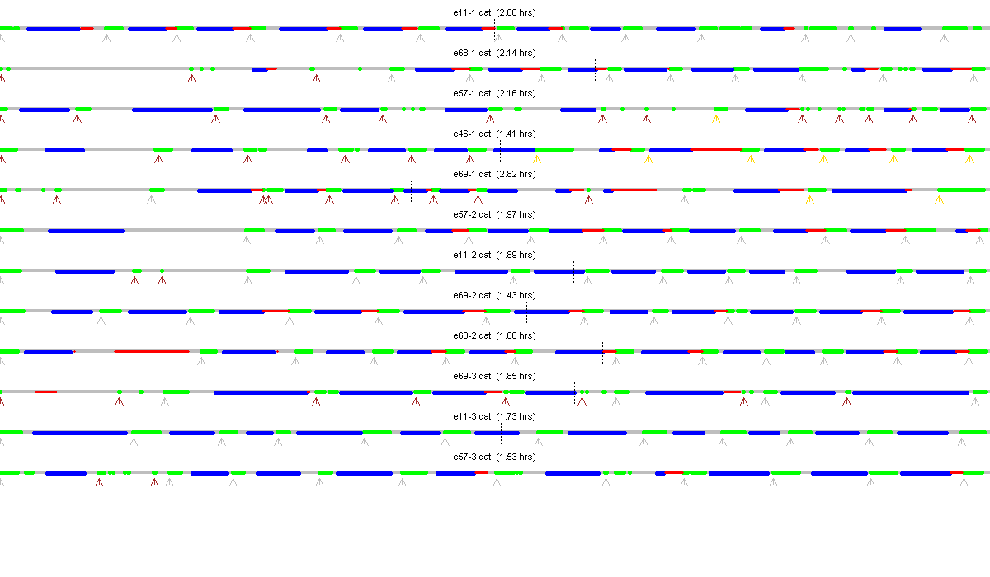

Slide 12
Signif.
Signif.

